Slide 1
What do People think about US politics
Omid Setayeshfar, Saber Soleimany, Mojtaba Fazli

Slide 2
Research Question
What are the areas of interest among people of French and English speaking countries in US politics?

Slide 3
Background
We started with what’s the attitude of the people of different nations about US politics
Problems :
Problem 1 :
It’s not possible to identify people’s location because we do not have it on twitter
People’s profile info does not point to their location
Problem 2:
The data gathering is tricky!
Partial Solution:
Guess people's location based on the language they speak

Slide 4
System Design
Select Sources
Select Sources
Run Machine Learning
Run Machine Learning
Analyze
Collect Data
Analyze
Collect
Data
Clean Data
Clean
Data

Slide 5
System Design - Detailed
Select political accounts
Filter them based on fame
Nltk Package
Case check
Tag removals (beautifulSoup)
Analyze extracted topics
Extract percentage of each topic
Select Sources
Collect
Data
Clean
Data
Run Machine Learning
Analyze
Tweeter API
TweePY
User Accounts
Topic modeling (LDA)
Repeat on languages

Slide 6
System Data Flow
14,858,400 tweets
150 GB data
Down sampled to 2,486,665 tweets
Topic Models for EN and FR
Select Sources
Select Sources
Run Machine Learning
Run Machine Learning
Analyze
Collect Data
Analyze
Collect
Data
Clean Data
Clean
Data
Results
32 political accounts
290,690 followers
38,278 selected users
More 40 Languages
Cleaned text
Document Term Matrix

Slide 7
Results – Topic Models
Topic Number | Possible Topic Title | Top words
Topic 0 | Election day | us like people one new w today day c know
Topic 1 | Media bios | gop b cnn g work z life everyone never free
Topic 2 | Middle east | trump time realdonaldtrump obama make syria house l every bill
Topic 3 | Foreign policy | russian h keep thing law foxnews q still yet power
Topic 4 | Populist rhetoric | back election first always trumprussia article take fact enough important
Topic 5 | Email Scandal | russia potus could war fbi breaking team change please tweet
Topic 6 | Congress relations | read going love congress thanks senate since done makes call
Topic 7 | Hillary’s plans | good let last best vote well things better hillary hope
Topic 8 | - | right president say u n trump v ever get stop
Topic 9 | Populist rhetoric | trump u man need american th thank america real media

Slide 8
Results – Topic Models - French
Topic Title | Top words | English Translation
- | a e via france pr o r youtube in plus | A E via France pr o r youtube in more
 | paris les k pen and non police francoisfillon faut is | Paris The K pen and not franco is fillon police need is
 | pen b jour rdc nouvelle afrique arr attentat fin gmail | Pen b day rdc New Africa arr attack end Gmail
International finance | merci apr change sidentielle r al fait lenchon lepen bon | Thank you exchange Apr sidentielle r al fact lenchon lepen good
 | q b cette peut dit marine cr depuis moins rien | q b This can marine said CR since less nothing
Canada relations | limportant res twitter int video comments canada pendant curit direct | important RES Twitter int video comments Canada during direct Safety
 | contre x quand z pays toujours dangerous vie vs officiel | Against x When z countries always dangerous life vs Official
 | vid i to va tous soir politique are pourquoi grand | vid i TB will all political evening are why large
Inter party connections | tout realdonaldtrump com selon republicans minecraft his april hui marion | Any realdonaldtrump com according to Republicans Minecraft his April Today Mariona
 | les r h trump vote mlp excellent fran champs tre | r h trump MLP vote excellent fran fields Tre

Slide 9
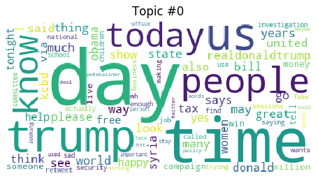
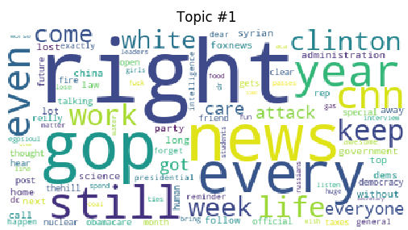
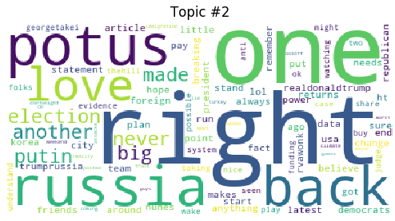
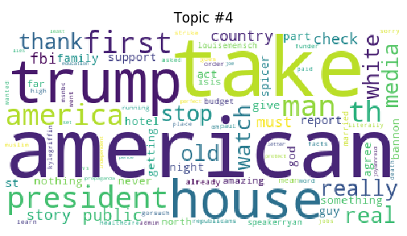
Results - EN :

Slide 10
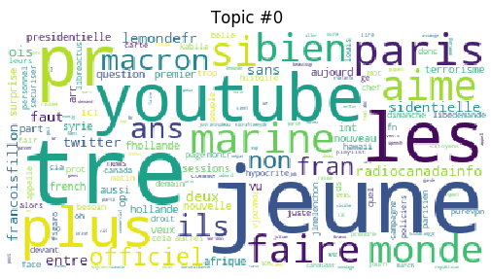
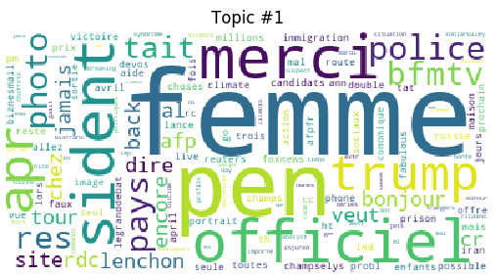
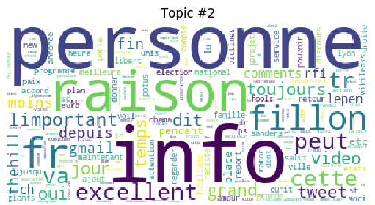
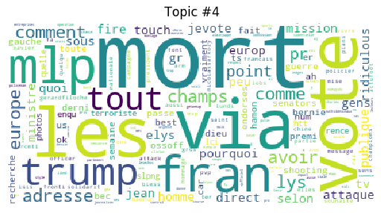
Results - FR :

Slide 11
Results – Interest Areas (EN)
People are interested in the followings :
Middle East
Foreign Policy including immigration
Media Bios
Populist rhetoric

Slide 12
Results – Interest Areas (FR)
People are interested in the followings:
US-Canada relations
US-France relation
US’s effect on international trade.
French speaking twitters seem to have a tendency towards accepting populist rhetoric of US campaigns

Slide 13
Interesting findings
YouTube is an important source for French speaking people (mostly in France ) where they get information
People interested in US politics are so diverse

